Slide 1
Chapter 1
The Role of Statistics in
Engineering

Slide 2
Introduction
For Today’s Graduate, Just One word: Statistics
-- New York Times, Aug. 6, 2009

Slide 3
“The rising stature of statisticians, who can earn $125,000 at top companies in their first year after getting a doctorate, is a byproduct of the recent explosion of digital data. In field after field, computing and the Web are creating new realms of data to explore — sensor signals, surveillance tapes, social network chatter, public records and more. And the digital data surge only promises to accelerate, rising fivefold by 2012, according to a projection by IDC, a research firm.”

Slide 4
Introduction
Statistics deals with making intelligent judgments and informed decisions in the presence of uncertainty and variation.
EXA Which is better in fighting cavities?
Crest or Colgate

Slide 5
Introduction
Statistics involves the collection, presentation, analysis, and use of data to
make decisions and solve problems.
Statistics is the science of data.

Slide 6
Goal of Statistics
Goal of Statistics - To make inferences about a population on the basis of a sample.
Population - entire collection of individuals or objects of interest
Sample - a subset of the population

Slide 7
Population Versus Sample
population
sample

Slide 8
Population Versus Sample
EXA Do the majority of Americans
believe in God?
It is impossible to ask every person in the U.S. so a sample is taken.
Population - all Americans
Sample - a subset of Americans

Slide 9
Variability
Statistical techniques are useful to describe and understand variability.
Variability means successive observations of a system or phenomenon do not produce exactly the same result.
Statistics gives us a framework for describing this variability and for learning about potential sources of variability.

Slide 10
Example of Variability
Eight prototype units are produced and their pull-off forces are measured (in pounds):
12.6, 12.9, 13.4, 12.3, 13.6, 13.5, 12.6, 13.1
All of the prototypes do not have the same pull-off force. We can see the variability in the above measurements as they exhibit variability. A dot diagram is useful to display a small body of data - say up to about 20.
Notes:
*
* * * * * * *
-----|----------|----------|----------|----------|----------|----------|----------|---
12.2 12.4 12.6 12.8 13.0 13.2 13.4 13.6

Slide 11
Branches of Statistics
Descriptive Statistics - part of statistics dealing with organizing and summarizing data
Inferential Statistics - part of statistics dealing with drawing conclusions about the population on the basis of a sample
(the goal!!)

Slide 12
Probability versus Statistics
Probability
Knowing the population, probability calculations can be made concerning a sample.
EXA For a fair die, what is the probability
that you toss at least 3 1’s in 20
tosses?

Slide 13
Probability versus Statistics
Statistics
Given the sample, we infer about the population.
EXA Out of 1000 Americans sampled, 880
believe in God. Do the majority of
Americans believe in God?

Slide 14
Probability versus Statistics
probability →
← statistics
population
sample

Slide 15
How is Data Collected?
  A retrospective study using historical data
    Data collected in the past for other purposes.
  An observational study
    Data, presently collected, by a passive observer.
  A designed experiment
    Data collected in response to process input changes. Treatments are deliberately imposed to observe a response.

Slide 16
How is Data Collected?
  A sample survey is an example of an observational study. No treatment is being deliberately imposed.
Basic form of an experiment:
Explanatory
variable(s) → Subjects → Response
(factor(s)) applied to yields

Slide 17
A Simple Experiment
Treatment New Relief
Group (100) → Medicine → Time
/ \
200 Compare
\ /
↑ Control → Sugar → Relief
| Group(100) Pill Time
|
randomization
Notes:
Completely Randomized Experiment

Slide 18
Data Collection
In order for statistical methods to work correctly and to produce valid results, random samples must be used. The most basic method of random sampling is simple random sampling.
A simple random sample (SRS) of size n is a sample that has been selected from a population in such a way that each possible sample of size n has an equally likely chance of being selected.

Slide 19
Data Collection
EXA Assume we have 30 people in this class. We want a SRS of size 4. How could we pick this sample?
We could write each name on a slip of paper - put the slips of paper in a box - mix -
draw 4 slips of paper (without
replacement)

Slide 20
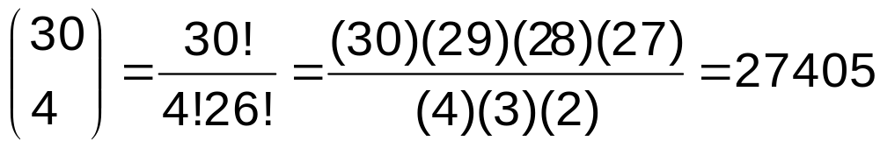
Data Collection
EXA Assume we have 30 people in this class. We want a SRS of size 4. How could we pick this sample?
There are
possibilities.
Numbering individuals 1, 2,…, 30, use R:
> sample(30,4)
[1] 15 12 18 9

Slide 21
Variable
A variable is any characteristic of an individual or object in the population of interest (each individual gives a value of the variable of interest)
(notation: X,Y,Z)
The value of the variable is the actual number (or category) observed for a particular individual. (notation: x,y,z)

Slide 22
Variable
Variables are quantitative or categorical (qualitative).
The value of a quantitative variable is obtained by a measurement or a count for an individual.
Examples include LENGTH, HEIGHT, WEIGHT, and NUMBER OF KEYS.

Slide 23
Variable
The value of a categorical variable depends on which of several categories an individual falls.
Examples include HAIR COLOR, RACE, and RELIGION.
Note: A variable’s value varies from individual to individual; it is not constant.
Notes:
Play with R a little bit and give R bonus exercise.

